Slide 1
Constraint Satisfaction Problems

Slide 2
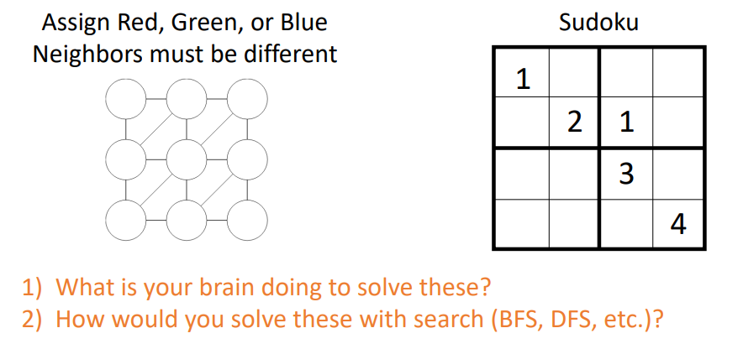

Slide 3
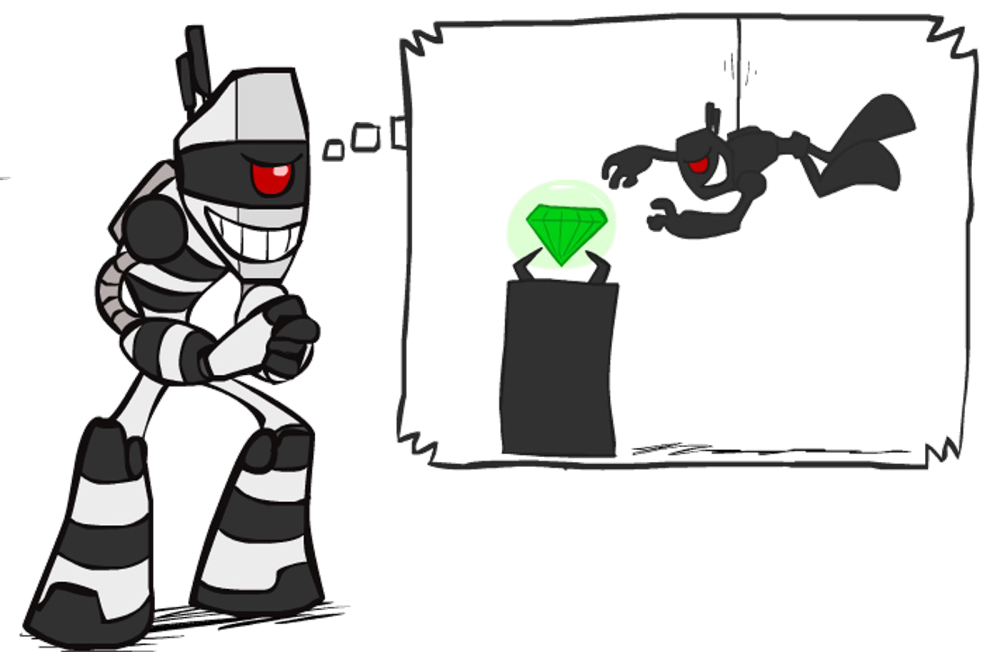

What is Search For?
Assumptions about the world: a single agent, deterministic actions, fully observed state, discrete state space
how to find optimal solutions to search problems, a type of planning problem.
Planning: sequences of actions
  The path to the goal is the important thing.
  Paths have various costs, depths.
  Heuristics give problem-specific guidance.
Identification: assignments to variables
  Identification Problems in which we must simply identify.
  whether a state is a goal state or not, with no regard to how we arrive at that goal.
  The goal itself is important, not the path.
  All paths at the same depth (for some formulations).

Slide 4


Constraint Satisfaction Problems
Components of (CSPs):
  Variables - CSPs possess a set of N variables X₁,...,X_{N} that can each take on a single value from some defined set of values.
  Domain - A set {x₁,..., x_{d}} representing all possible values that a CSP variable can take on.
  Constraints define restrictions on the values of variables, potentially with regard to other variables.
  or
  A goal test is a set of constraints specifying allowable combinations of values for subsets of variables

Slide 5
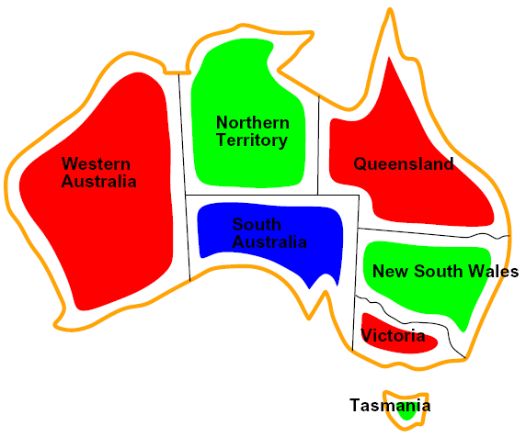

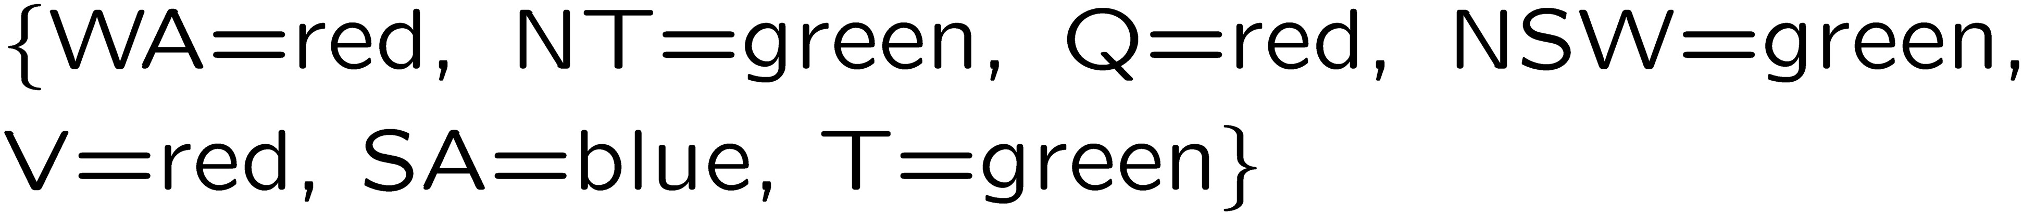
Example: Map Coloring
Variables:
Domains:
Constraints: adjacent regions must have different colors
Implicit:
Explicit:
Solutions are assignments satisfying all constraints, e.g.:
Explicit constraints are directly specified in the problem formulation, while implicit constraints are inferred from the problem context or relationships between variables.

Slide 6

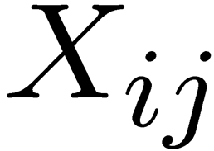

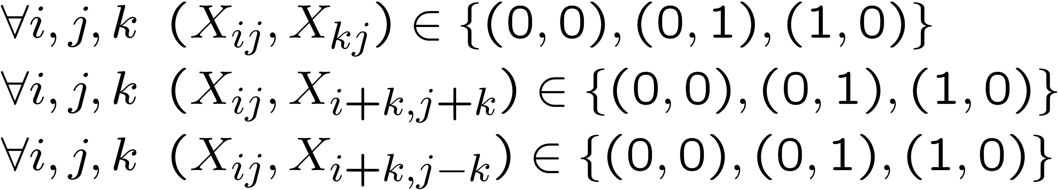
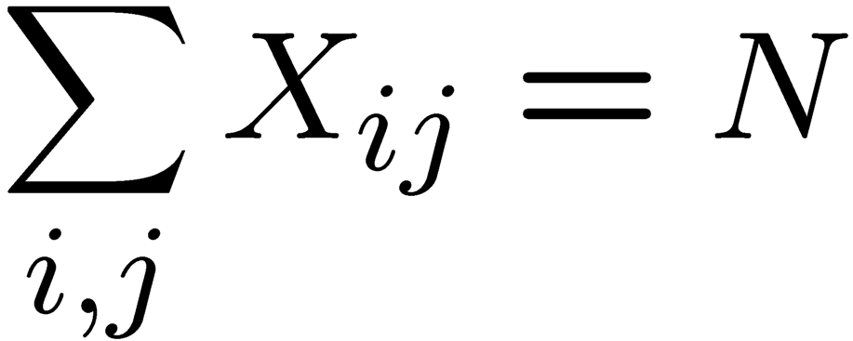
Example: N-Queens
Formulation 1:
  Variables:
  Domains:
  Constraints
Position at same row
This constraint states that we must have exactly N grid positions marked with a 1, and all others marked with a 0, capturing the requirement that there are exactly N queens on the board.

Slide 7

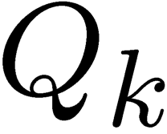


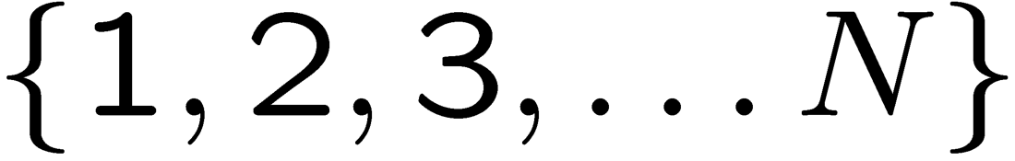


Example: N-Queens
Formulation 2:
  Variables:
  Domains:
  Constraints:
Explicit:

Slide 8
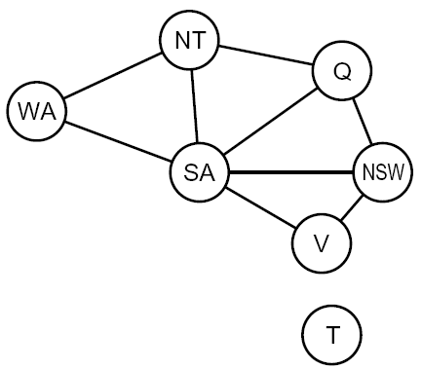
Constraint Graphs
Constraint satisfaction problems are often represented as constraint graphs, where nodes represent variables and edges represent constraints between them. There are many different types of constraints, and each is handled slightly differently:
Binary CSP: each constraint relates (at most) two variables
Binary constraint graph: nodes are variables, arcs show constraints.
General-purpose CSP algorithms use the graph structure to speed up search. E.g., Tasmania is an independent subproblem!

Slide 9
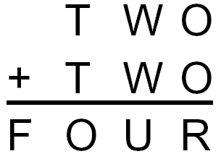
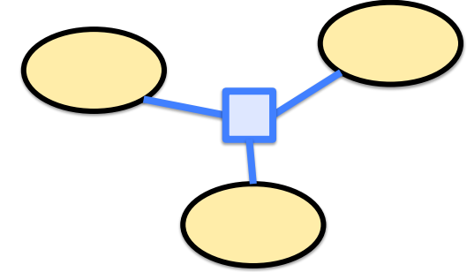
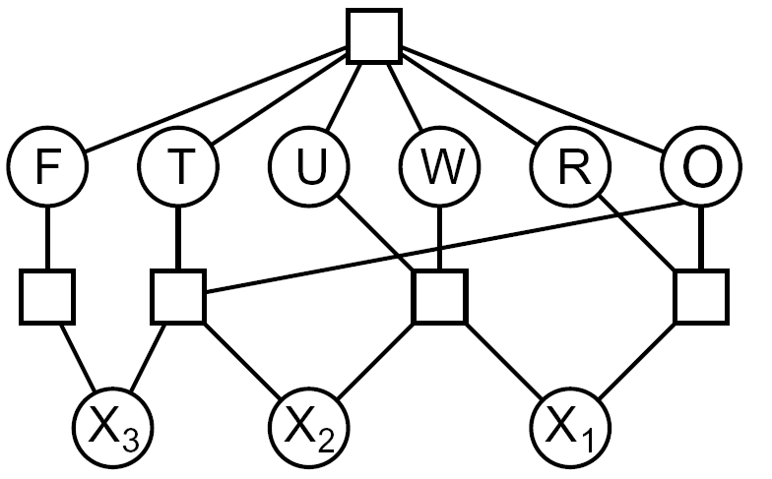

Example: Cryptarithmetic
Type of mathematical puzzle where letters represent digits in an arithmetic equation. The goal is to find the correct digit substitution for each letter to make the equation true.
Variables:
Domains:
Constraints:
In a hypergraph, hyperedges connect multiple vertices:
Every different letter will have a different value

Slide 10
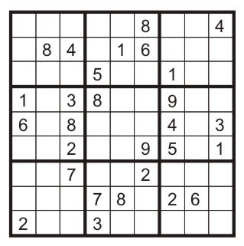
Example: Sudoku
Variables:
  Each (open) square
Domains:
{1,2,…,9}
Constraints:
9-way alldiff for each column
9-way alldiff for each row
9-way alldiff for each region
(or can have a bunch of pairwise inequality constraints)

Slide 11
Varieties of CSPs
Discrete Variables
  Finite domains
Variables: Each region on the map is a variable.
Domains: Each variable can have a finite number of possible values ( red, green, blue) .
Constraints: Two neighboring regions cannot have the same color.
Solving such a problem involves finding "coloring" where neighboring regions differ in color.
This CSP problem with finite domains can be solved efficiently, similar to checking all possible combinations in a small puzzle.
CSP is complete in O(d^{n}) time, where d = size of the domain and n = number of variables.

Slide 12


Varieties of Constraints
Varieties of Constraints
  Unary constraints involve a single variable (equivalent to reducing domains), e.g.:
  Binary constraints involve pairs of variables, e.g.:
  Higher-order constraints involve 3 or more variables: e.g., cryptarithmetic column constraints
Preferences (soft constraints):
  E.g., red is better than green

Slide 13
Real-World CSPs
Scheduling problems: e.g., when can we all meet?
Timetabling problems: e.g., which class is offered when and where?
Assignment problems: e.g., who teaches what class
Hardware configuration
Transportation scheduling
Factory scheduling
Circuit layout
Fault diagnosis
… lots more!
Many real-world problems involve real-valued variables…

Slide 14
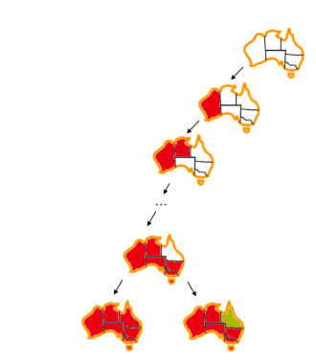
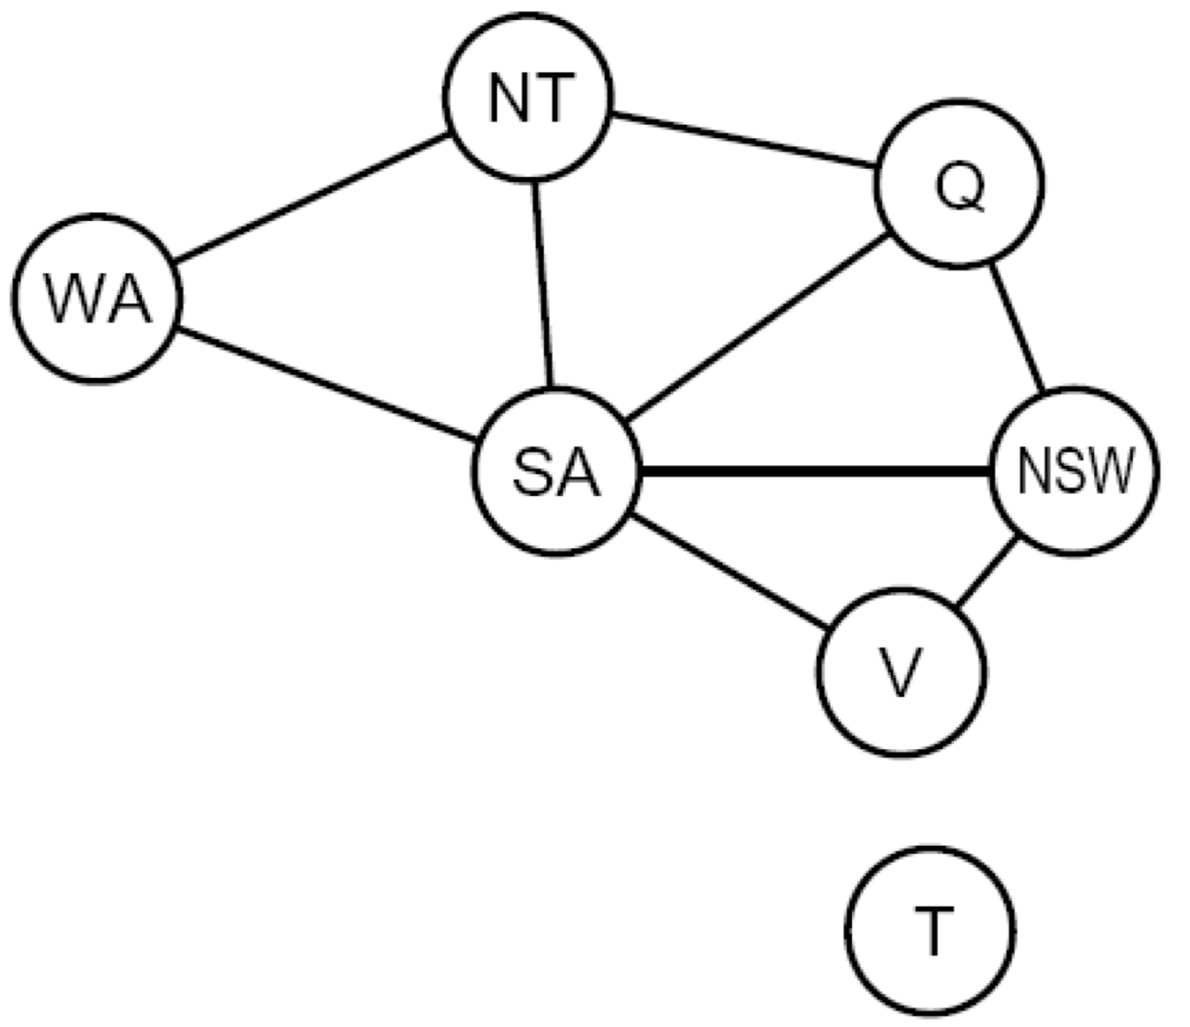
Search Methods
What would DFS do?
What would BFS do?
What problems does naïve search have?
NO idea about the rules

Slide 15
Backtracking Search
Backtracking search is the basic uninformed algorithm (DFS) for solving CSPs
  Idea 1: One variable at a time
    Fix an ordering for variables, and select values for variables in this order.
    Assignments are commutative (e.g. assigning WA = Red, NT = Green is identical to NT = Green, WA = Red), this is valid.
    Only need to consider assignments to a single variable at each step
  Idea 2: Check constraints as you go
    I.e. consider only values which do not conflict with previous assignments
    “Incremental goal test”.
Depth-first search with these two improvements is called backtracking search
Can solve n-queens for n = 25

Slide 16

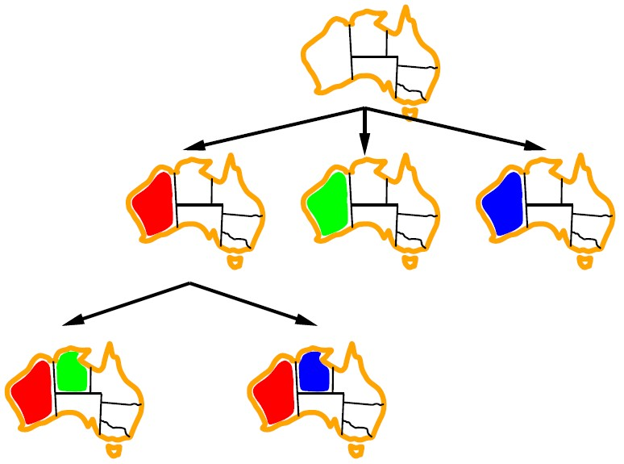
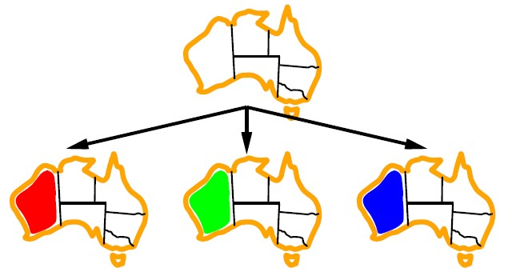
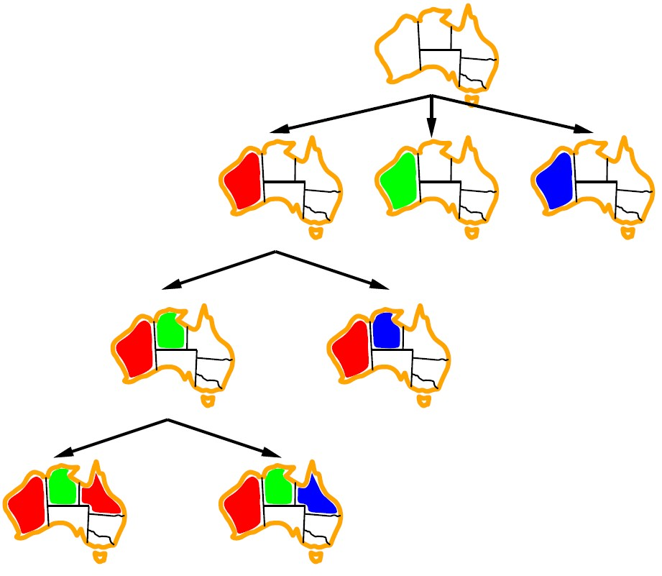
Backtracking Example

Slide 17
Backtracking Search
Notes:
Demo:
CS188 javascript demos -> source -> exercises -> csps -> CSPs demos -> CSPs demos.html
Settings:
Graph = Simple
Algorithm = Backtracking
Ordering = None
Filtering = None

Slide 18
Backtracking Search
No need to check constraints for a complete assignment
Notes:
Demo:
CS188 javascript demos -> source -> exercises -> csps -> CSPs demos -> CSPs demos.html
Settings:
Graph = Simple
Algorithm = Backtracking
Ordering = None
Filtering = None

Slide 19
Backtracking Search
Checks consistency at each assignment
Notes:
Demo:
CS188 javascript demos -> source -> exercises -> csps -> CSPs demos -> CSPs demos.html
Settings:
Graph = Simple
Algorithm = Backtracking
Ordering = None
Filtering = None

Slide 20
Backtracking Search
Backtracking = DFS + variable-ordering + fail-on-violation
Notes:
Demo:
CS188 javascript demos -> source -> exercises -> csps -> CSPs demos -> CSPs demos.html
Settings:
Graph = Simple
Algorithm = Backtracking
Ordering = None
Filtering = None

Slide 21
Improving Backtracking
General-purpose ideas give huge gains in speed
Filtering:
  Can we detect inevitable failure early?
Ordering:
  Which variable should be assigned next?
  In what order should its values be tried?
Structure: Can we exploit the problem structure?

Slide 22


Filtering: Forward Checking
Filtering: which checks if we can prune the domains of unassigned variables ahead of time by removing values.
Forward checking: Cross off values that violate a constraint when added to the existing assignment
_{WA} NT
Q
NSW
V
SA

Slide 23
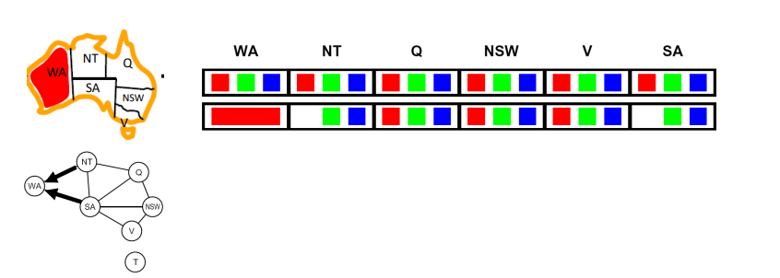
Filtering: Forward Checking
Filtering: Which checks if we can prune the domains of unassigned variables ahead of time by removing values we know will result in backtracking.
Forward checking: Cross off values that violate a constraint when added to the existing assignment

Slide 24
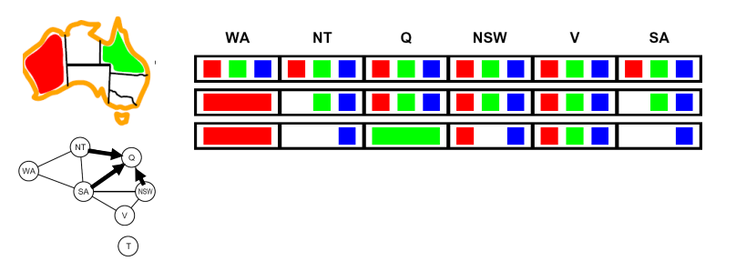
Filtering: Forward Checking
Filtering: which checks if we can prune the domains of unassigned variables ahead of time by removing values we know will result in backtracking
Forward checking: Cross off values that violate a constraint when added to the existing assignment

Slide 25
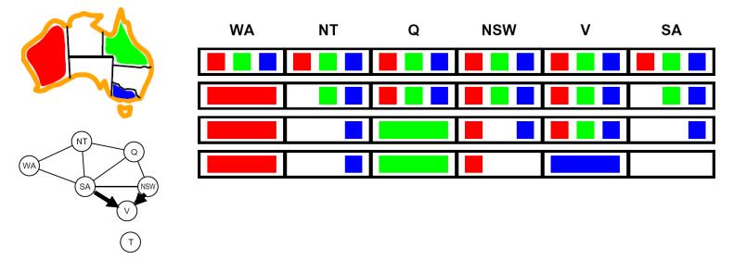
Filtering: Forward Checking
Filtering: which checks if we can prune the domains of unassigned variables ahead of time by removing values we know will result in backtracking
Forward checking: Cross off values that violate a constraint when added to the existing assignment

Slide 26
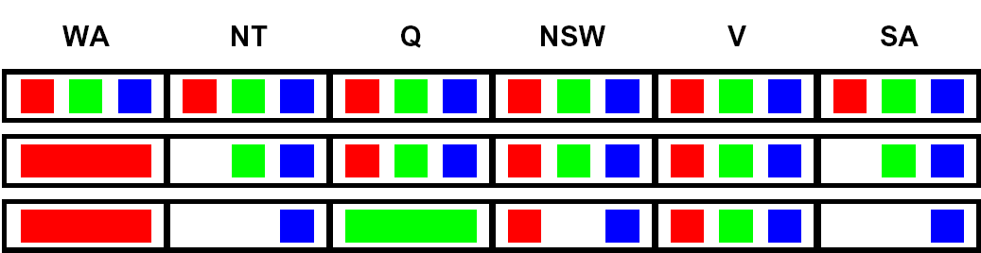
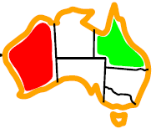
Filtering: Constraint Propagation
Forward checking propagates information from assigned to unassigned variables, but doesn't provide early detection for all failures:
NT
SA
Q
NSW
V
WA
NT and SA cannot both be blue!
Why didn’t we detect this yet?
Constraint propagation: reason from constraint to constraint

Slide 27

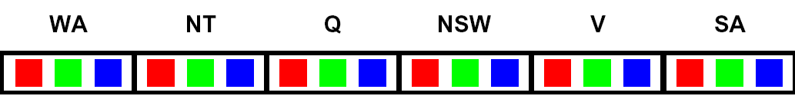

Consistency of A Single Arc
An arc X → Y is consistent iff for every x in the tail there is some y in the head which could be assigned without violating a constraint.
Remove values in the domain of X if there isn’t a corresponding legal Y.
NT
SA
Q
NSW
V
WA
Tail = NT, head = WA
  If NT = blue: we could assign WA = red
  If NT = green: we could assign WA = red
  If NT = red: there is no remaining assignment to WA that we can use
  We do not want inconsistent arcs they are of no use.
  Deleting NT = red from the tail makes this arc consistent
Forward checking: Enforcing consistency of arcs pointing to each new assignment

Slide 28
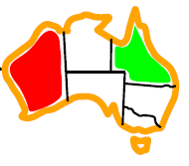
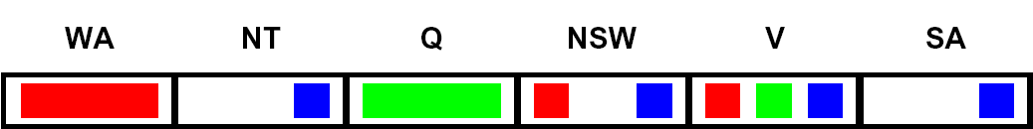
Arc Consistency of an Entire CSP (1/6)
A simple form of propagation makes sure all arcs are consistent:
NT
SA
Q
NSW
V
WA
Arc V to NSW is consistent: for every x in the tail there is some y in the head which could be assigned without violating a constraint

Slide 29
Arc Consistency of an Entire CSP (2/6)
A simple form of propagation makes sure all arcs are consistent:
NT
SA
Q
NSW
V
WA
Arc SA to NSW is consistent: for every x in the tail there is some y in the head which could be assigned without violating a constraint

Slide 30
Arc Consistency of an Entire CSP (3/6)
A simple form of propagation makes sure all arcs are consistent:
NT
SA
Q
NSW
V
WA
Arc NSW to SA is not consistent: if we assign NSW = blue, there is no valid assignment left for SA
To make this arc consistent, we delete NSW = blue from the tail

Slide 31
Arc Consistency of an Entire CSP (4/6)
A simple form of propagation makes sure all arcs are consistent:
NT
SA
Q
NSW
V
WA
Remember that arc V to NSW was consistent, when NSW had red and blue in its domain
After removing blue from NSW, this arc might not be consistent anymore! We need to recheck this arc.
Important: If X loses a value, neighbors of X need to be rechecked!

Slide 32
Arc Consistency of an Entire CSP (5/6)
A simple form of propagation makes sure all arcs are consistent:
NT
SA
Q
NSW
V
WA
Arc SA to NT is inconsistent. We make it consistent by deleting from the tail (SA = blue).

Slide 33
Arc Consistency of an Entire CSP (6/6)
A simple form of propagation makes sure all arcs are consistent:
NT
SA
Q
NSW
V
WA
SA has an empty domain, so we detect failure. There is no way to solve this CSP with WA = red and Q = green, so we backtrack.
Arc consistency detects failure earlier than forward checking
Can be run as a preprocessor or after each assignment

Slide 34
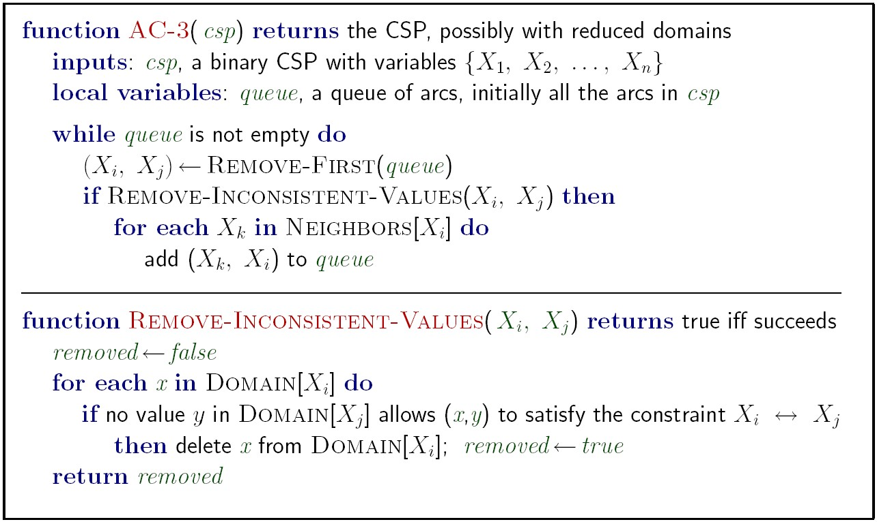
Enforcing Arc Consistency in a CSP
Runtime: O(n²d³),

Slide 35
Limitations of Arc Consistency
After enforcing arc consistency:
  Can have one solution left
  Can have multiple solutions left
  Can have no solutions left (and not know it)
Solution possible or not?
What went wrong here?

Slide 36
K-Consistency
Increasing degrees of consistency
  1-Consistency (Node Consistency): Each single node’s domain has a value which meets that node’s unary constraints
  2-Consistency (Arc Consistency): For each pair of nodes, any consistent assignment to one can be extended to the other
  K-Consistency: For each k nodes, any consistent assignment to k-1 can be extended to the k^{th} node.
Higher k more expensive to compute
(You need to know the k=2 case: arc consistency)

Slide 37
Question
Would it be better to branch on the most constrained or the least constrained variable next?

Slide 38
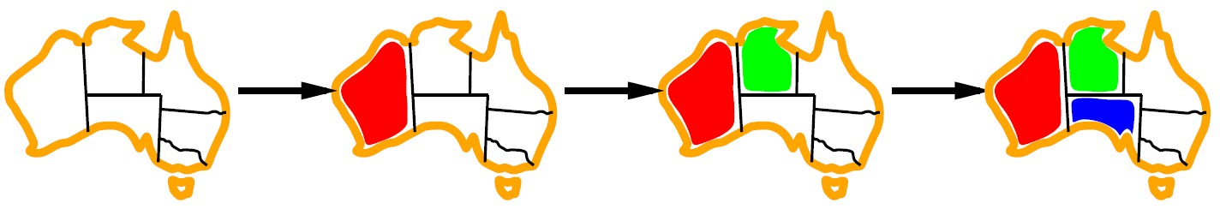
Ordering: Minimum Remaining Values
Variable Ordering: Minimum remaining values (MRV):
  Choose the variable with the fewest legal left values in its domain
Also called “most constrained variable”

Slide 39
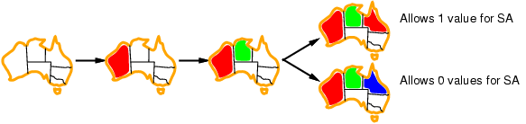
Ordering: Least Constraining Value
Value Ordering: Least Constraining Value
  Given a choice of variable, choose the least constraining value
  I.e., Look for the value that creates the least restrictions on other variables.
  Note that it may take some computation to determine this! (E.g., rerunning filtering)
Combining these ordering ideas makes 1000 queens feasible

Slide 40
Structure
A final class of improvements to solving constraint satisfaction problems are those that exploit their structure. In particular, if we’re trying to solve a tree-structured CSP (one that has no loops in its constraint graph).
First, pick an arbitrary node in the constraint graph for the CSP to serve as the root of the tree .
Convert all undirected edges in the tree to directed edges pointing away from the root node (designated as node A).
Linearize (or topologically sort) the resulting directed acyclic graph by ordering the nodes such that all edges point rightwards, representing a consistent direction of traversal away from the root node.

Slide 41
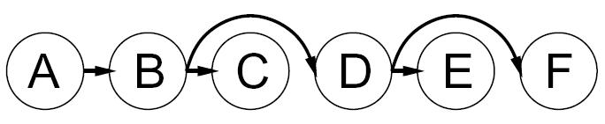
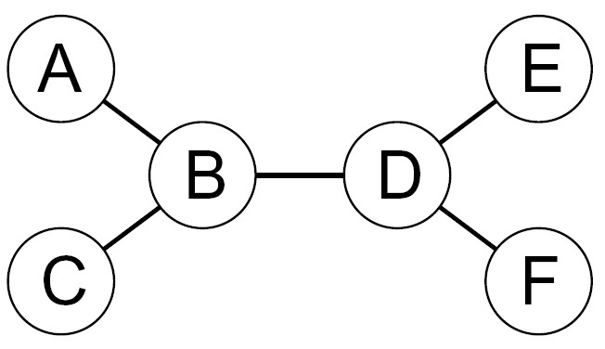
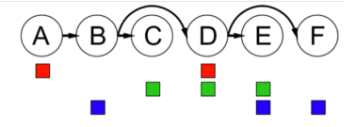
Tree-Structured CSPs
Algorithm for tree-structured CSPs:
  Order: Choose a root variable, order variables so that parents precede children
Remove backward: Iterating from i = n down to i = 2, enforce arc consistency for all arcs Parent(X_{i}) → Xi (Check consistency if not make it )
Assign forward: For i = 1 : n, assign X_{i} consistently with Parent(X_{i})

Slide 42
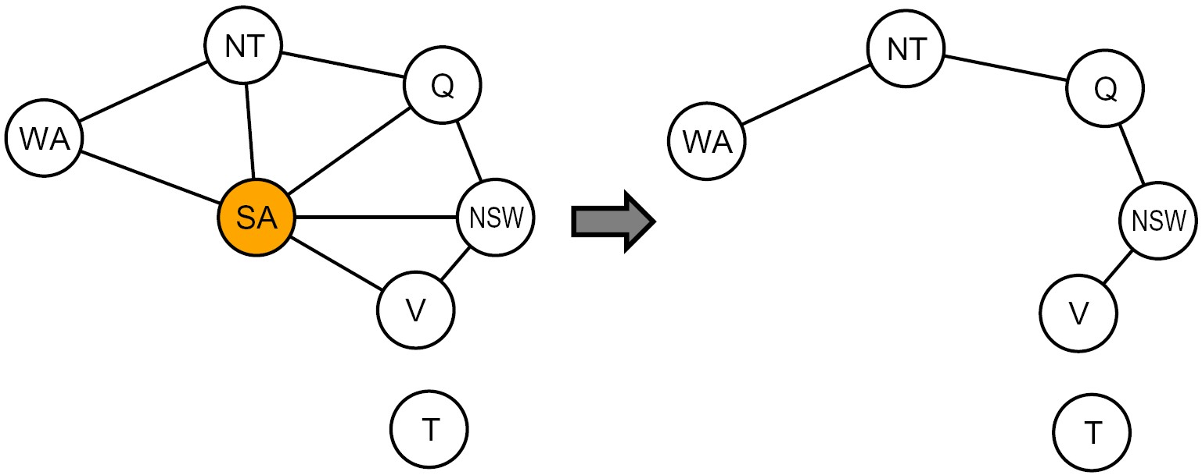
Nearly Tree-Structured CSPs
Remove SA
Conditioning: instantiate a variable, prune its neighbors' domains
Cutset conditioning: instantiate (in all ways) a set of variables such that the remaining constraint graph is a tree

Slide 43
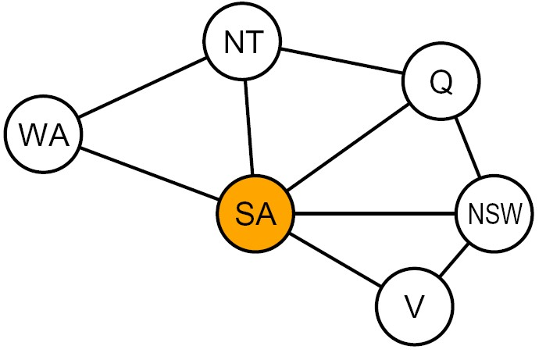
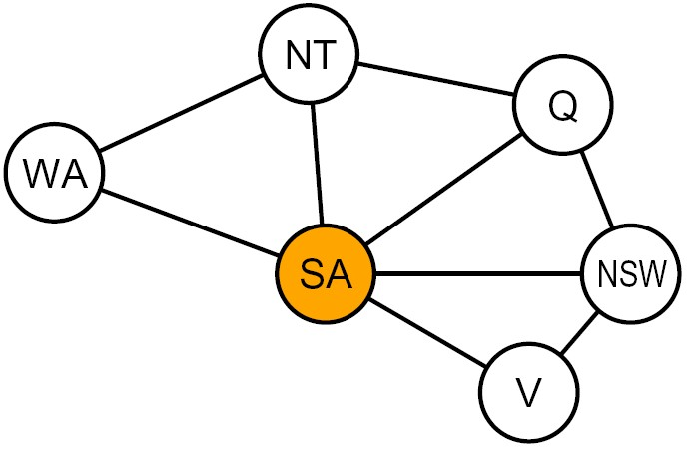


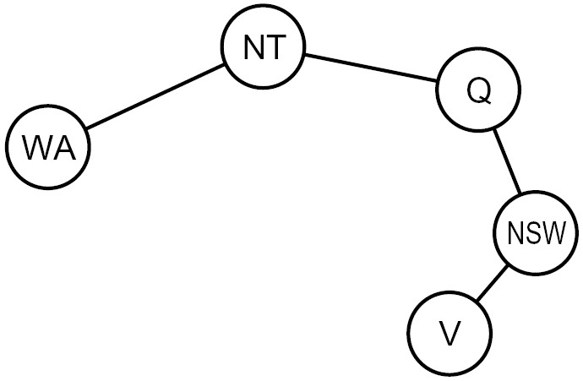
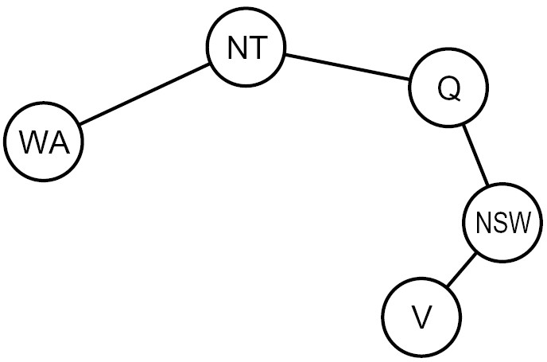

Cutset Conditioning
Choose a cutset
SA
Instantiate the cutset (all possible ways)
SA
SA
SA
Compute residual CSP for each assignment
Solve the residual CSPs (tree structured)

Slide 44
Iterative Algorithms for CSPs
Backtracking search is not the only algorithm that exists for solving constraint satisfaction problems.
Another widely used algorithm is local search, for which the idea is simple but remarkably useful.

Slide 45
local search
Tree search keeps unexplored alternatives on the fringe (ensures completeness)
Local search: improve a single option until you can’t make it better (no fringe!)
To Apply to CSPs:
  Take an assignment with unsatisfied Constraints
  Operators reassign variable values
  No fringe
Possible local Changes
Initial assignment
Algorithm: While not solved,
    Variable selection: randomly select any conflicted variable
    Value selection: min-conflicts heuristic:
      Choose a value that violates the fewest constraints
      I.e., hill climb with h(n) = total number of violated constraints

Slide 46
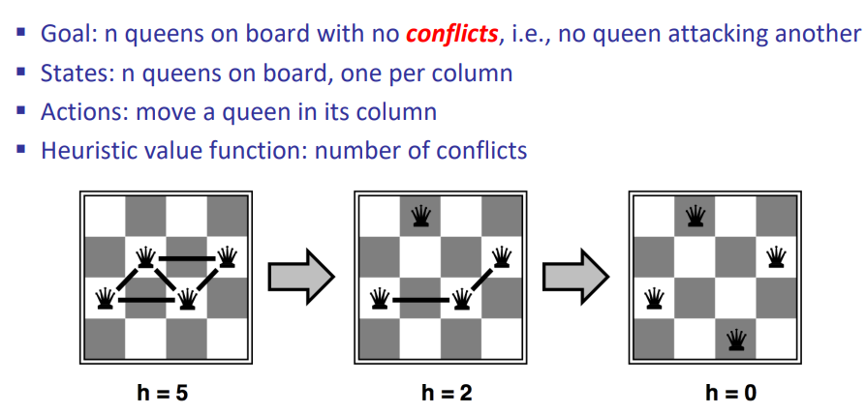
Example: 4-Queens

Slide 47
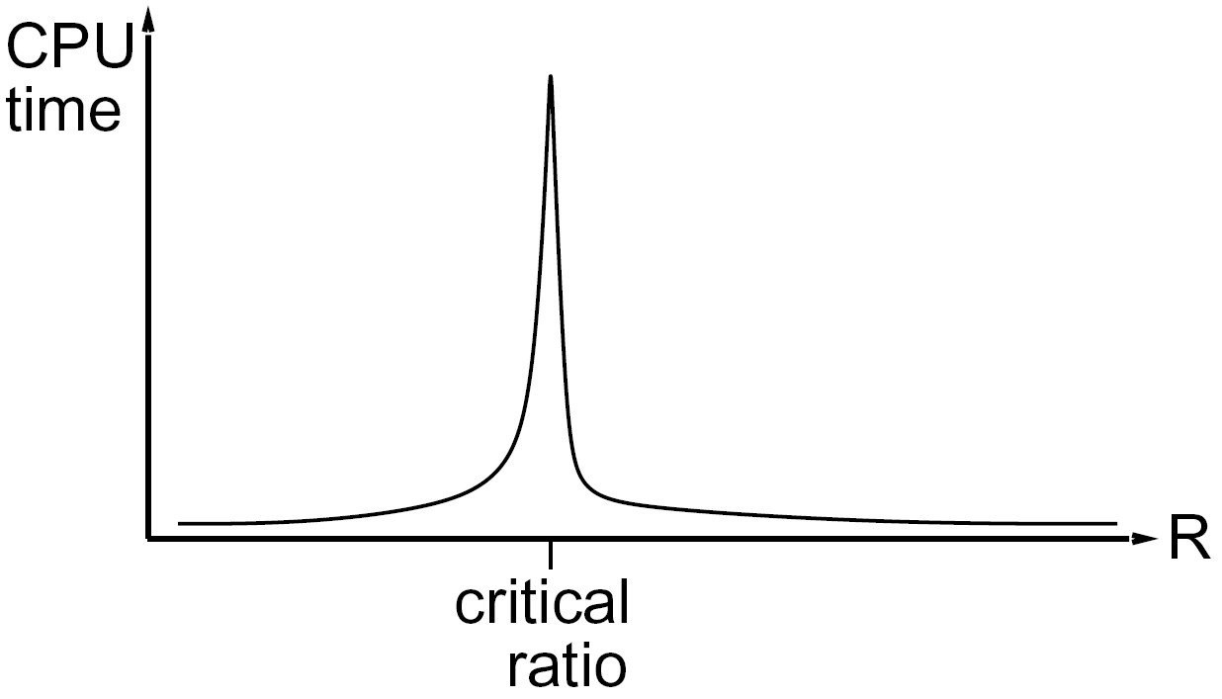
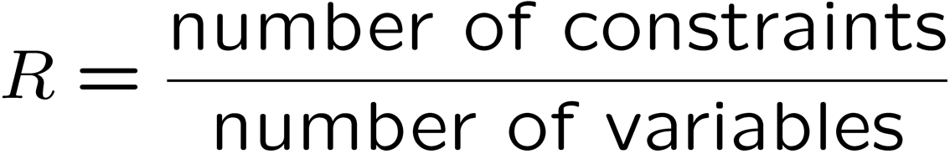
Performance of Min-Conflicts
Given a random initial state, can solve n-queens in almost constant time for arbitrary n with high probability (e.g., n = 10,000,000)!
The same appears to be true for any randomly generated CSP except in a narrow range of the ratio.
However, local search is both incomplete and suboptimal and so won’t necessarily converge to an optimal solution.
Additionally, there is a critical ratio around which using local search becomes extremely expensive:
The time needed by iterative algo to get to solution
R very small i.e. Number of Constraints is less and variables are a lot
R very large i.e. Number of Constraints are lot and few variables

Slide 48
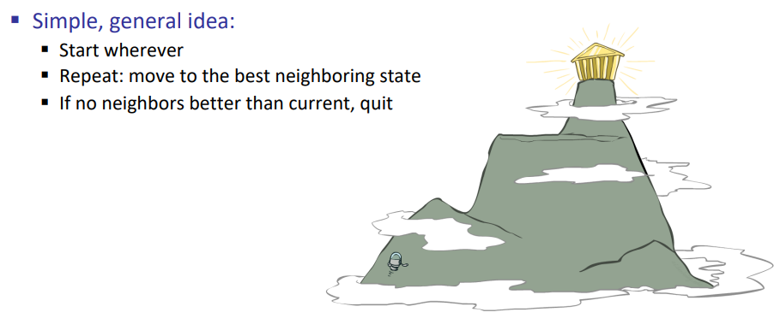
Hill Climbing

Slide 49
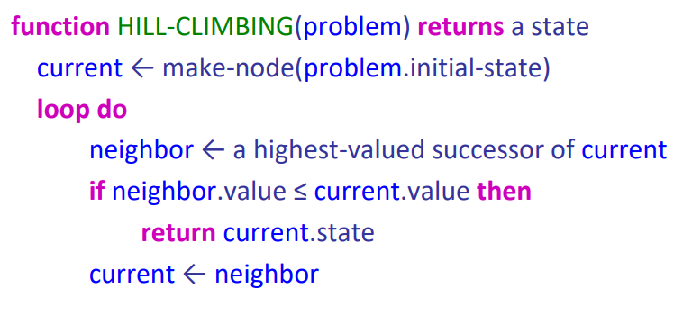
Hill Climbing

Slide 50
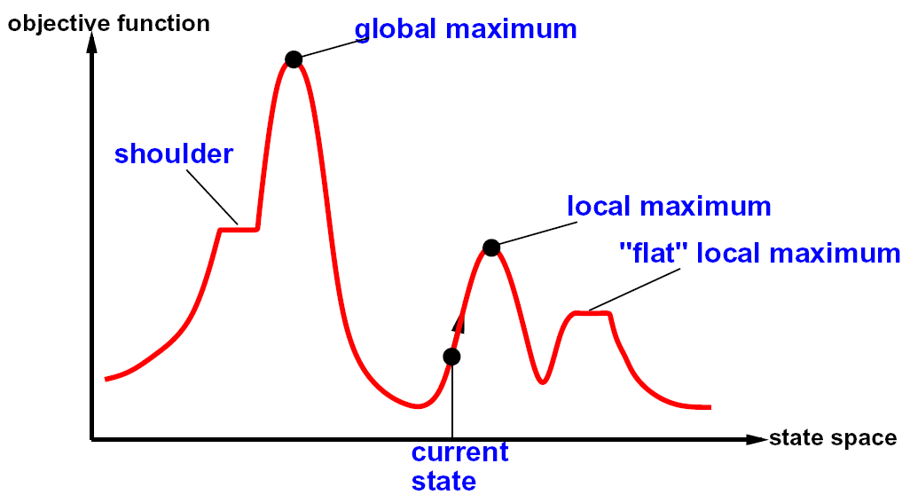
Hill Climbing Diagram

Slide 51
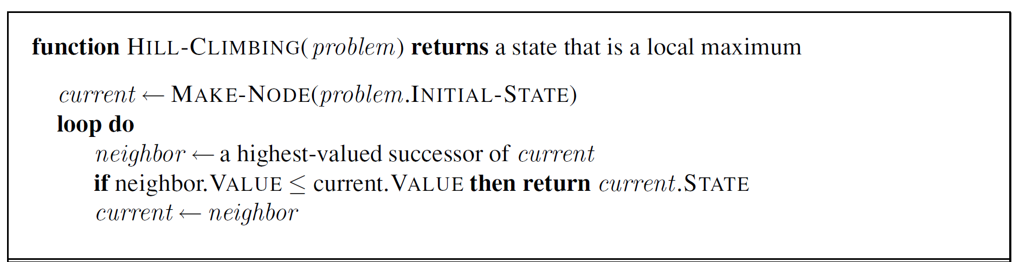
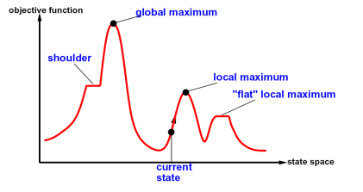
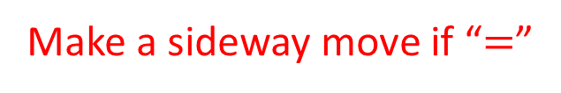
Hill Climbing (Greedy Local Search)
What if there is a tie?
Typically break ties randomly
What if we do not stop here?
Make a sideway move if “$=$”

Slide 52
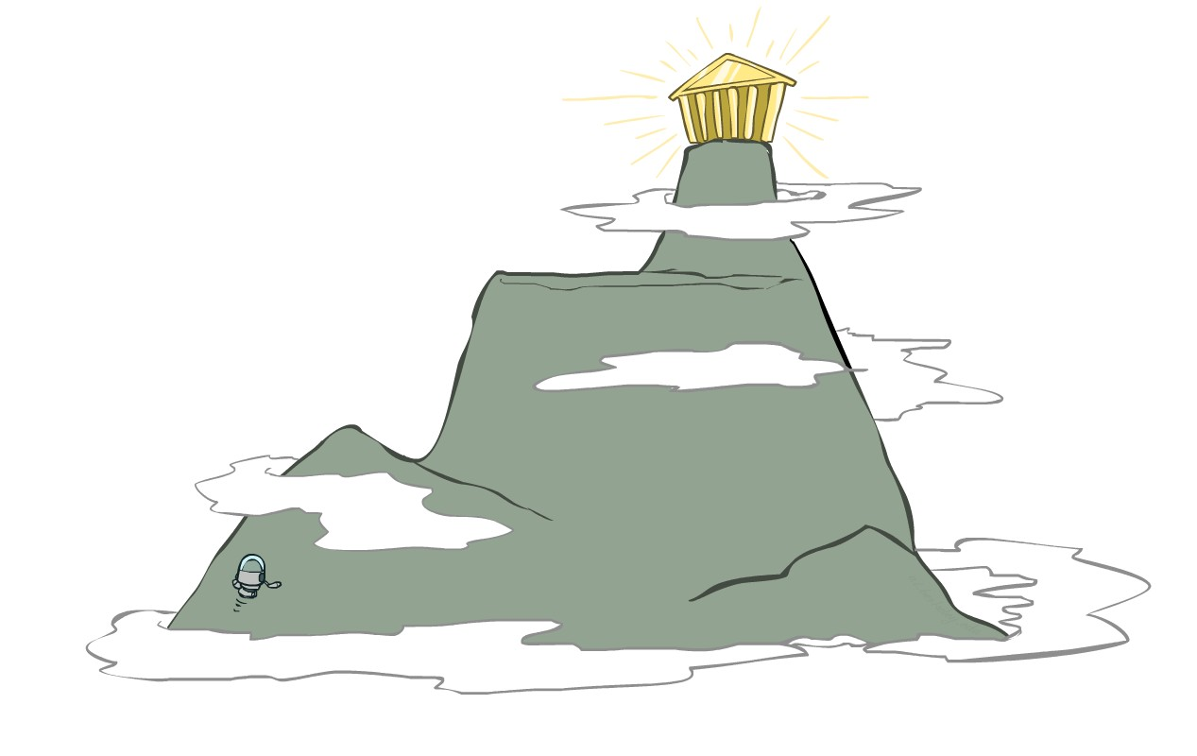
Hill Climbing Greedy Local Search
Simple, general idea:
  Start wherever
  Repeat: move to the best neighboring state
  If no neighbors better than current, quit
What’s bad about this approach?
  Complete?
  Optimal?
What’s good about it?

Slide 53
Hill-climbing on 8-Queens
Randomly generated 8-queens starting states.
14% the time it solves the problem
86% of the time it get stuck at a local minimum
However…
    Takes only 4 steps on average when it succeeds
    And 3 on average when it gets stuck
    (for a state space with 8^8 =~17 million states)

Slide 54
Escaping Shoulders: Sideways Move
If no downhill (uphill) moves, allow sideways moves in hope that algorithm can escape
  Must limit the number of possible sideways moves to avoid infinite loops
  For 8-queens
Allow sideways moves with limit of 100
Raises percentage of problems solved from 14 to 94%
  However….
21 steps for every successful solution
64 for each failure

Slide 55
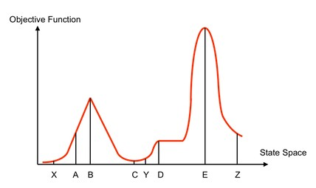
Hill Climbing
Starting from X, where do you end up ?
Starting from Y, where do you end up ? Starting from Z, where do you end up ?

Slide 56
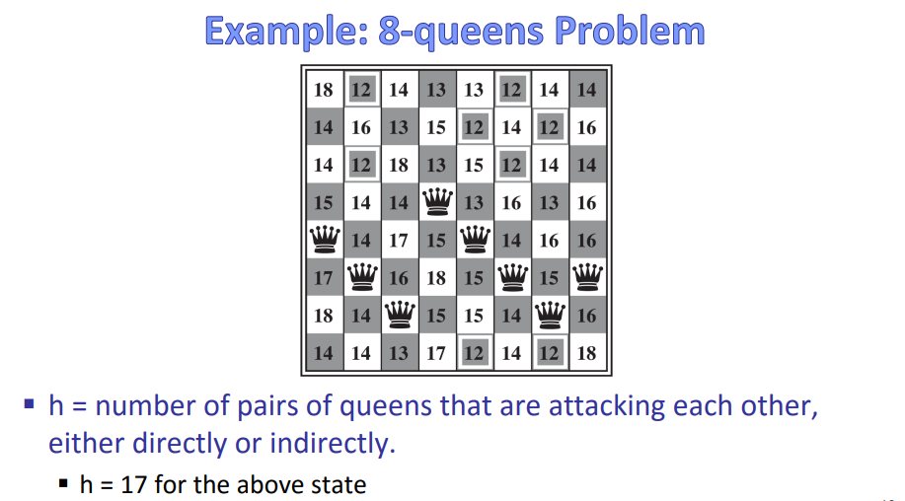
Direct attacks: A queen can attack another queen directly if they are in the same row, column, or diagonl
Indirect attacks: A queen can also attack another queen indirectly if there is a clear path between them without any other pieces blocking the attack.
What should be the next state

Slide 57


Slide 58

Variants of Hill Climbing
Stochastic hill climbing chooses at random from among the uphill moves.
  At each step do one of the following:
    Greedy: With prob p move to the neighbor with the largest value
    Random: With prob 1-p move to a random neighbor
The parameter p controls the balance between exploitation (moving towards the best neighbor) and exploration (moving to a random neighbor). A higher value of p favors exploitation, while a lower value favors exploration.
Random-restart hill climbing
With random restart values

Slide 59

Variants of Hill Climbing
What if variables are continuous, e.g., find $x∈[0,1]$ that maximizes $f\left(x\right)$?
  Gradient ascent
    Use gradient to find best direction
    Use the magnitude of the gradient to determine how big a step you move
Value space of variables

Slide 60


